Slide 1
City of St. Louis Service Requests
Project One
Data Analytics Bootcamp

Slide 2

Theodore Moreland Brian Kramer Renee O'Reilly

Slide 3
Project Selection
Housing Data – American Community Survey
6,500 Variables
St. Louis City Service Calls – Citizens’ Service Bureau (CSB) Service Requests
19 Variables

Slide 4
Scope of Project: Are requests submitted to the CSB affected by geography, type, weather, and time of year from 2016 to 2018
Research Questions:
Are there different rates in overall service requests across the 28 wards of St. Louis
Are there Certain Areas of the City that have Submitted more Service Requests
is there a difference in the type of Pothole Service Request by Year and Overall
Is there a Correlation between Service Requests and Average Monthly Temperature
Are there different rates in overall service requests by month and year

Slide 5
API vs CSV
API Difficulty
Limitations
1000 rows or 90 days
CSV Available for each year
2008 – 2018
*Warning – opening CSV in Excel

Slide 6
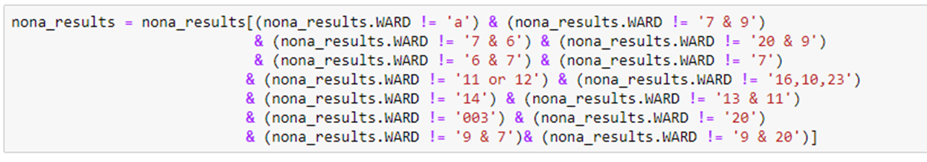
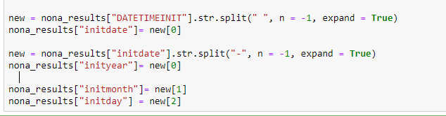
Cleaning the DAta
Deleting and Removing Non-essential Data
Columns and N/A
Rows
Formatting
Rows
Columns

Slide 7
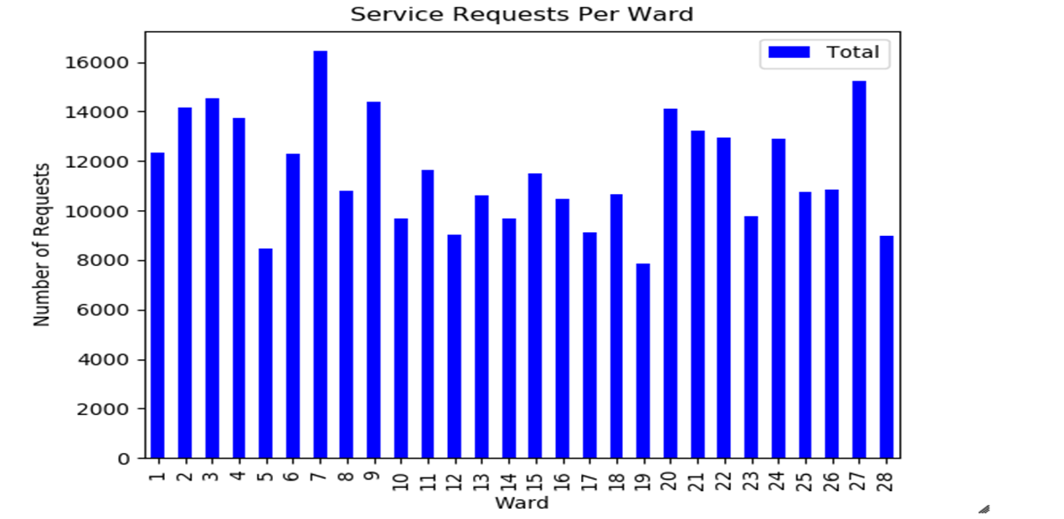
Data Analysis: Are there different rates in overall service requests across the 28 wards of St. Louis

Slide 8
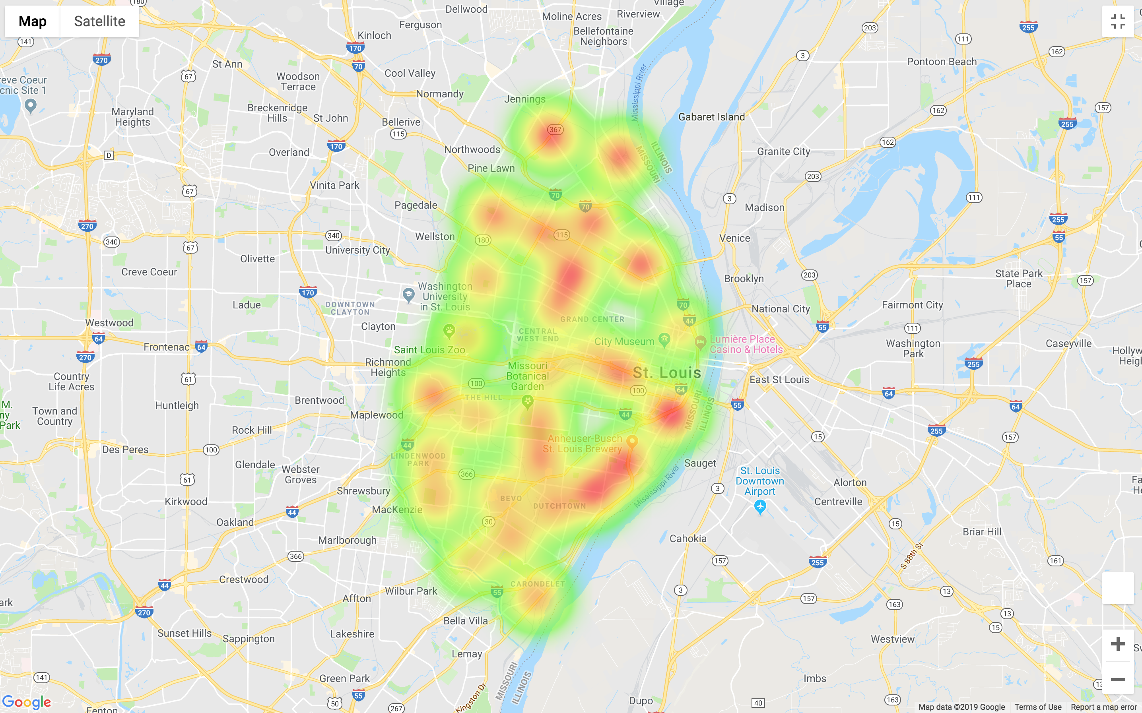
Data Analysis: Are there Certain Areas of the City that have Submitted more Service Requests
Requests by Ward
The heat map shows the highest concentration of requests in downtown St. louis and directly south of the city.
The figure also shows a weak line running north/south and might indicate request along Kingshighway.

Slide 9
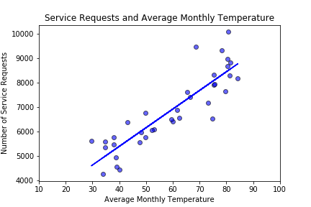
Data Analysis: Is there a Correlation between Service Requests and Average Monthly Temperature
Positive Correlation
As the temperature increases the number of service requests increases

Slide 10
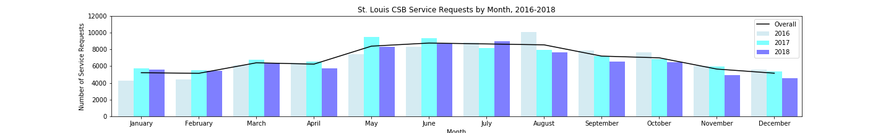
Data Analysis: Are there different rates in overall service requests by month and year
The summer months of May – August have a higher number of service requests
Possibly due to more individuals out or damage from the winter weather
Notes:
Polar Vortex

Slide 11
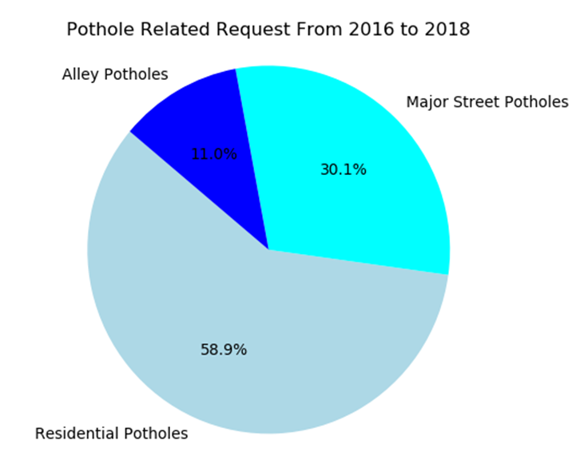
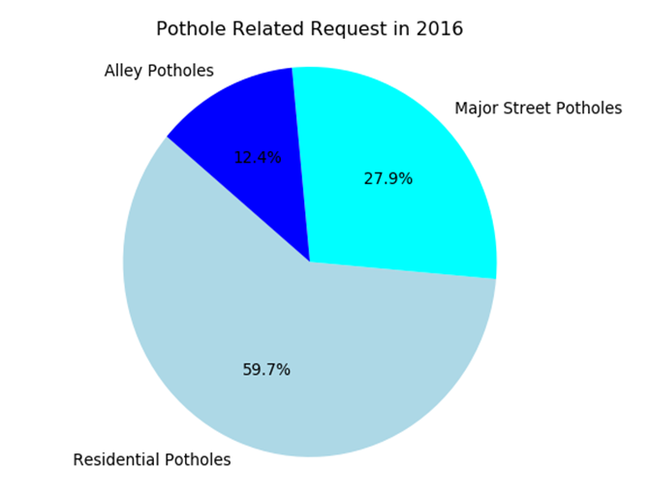
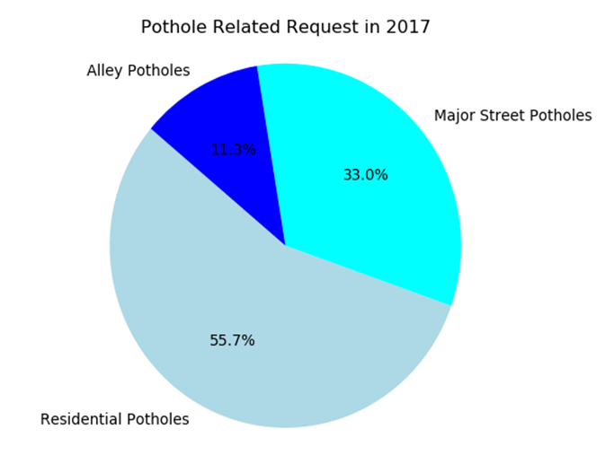
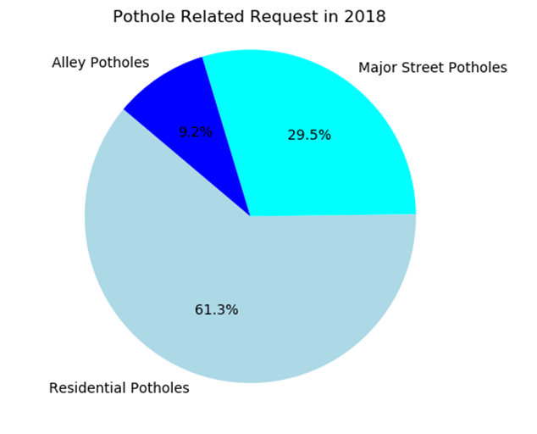
Data Analysis: is there a difference in the type of Pothole Service Request by Year and Overall

Slide 12
Conclusions
Are requests submitted to the CSB affected by geography, type, weather, and time of year from 2016 to 2018
St. Louis wards had different number of service requests
Ward #7 had approximately 16,000 service requests, while Ward #19 only had about 7,800. Not much can be inferred from those findings alone, but the disparity does give us a basis for further analysis.
Highest number of requests occurred in the downtown area which may be indicative of people traveling to the area for work and entertainment and reporting issues
Service request concerning potholes are most common for residential areas and least common when regarding alleys. Request made for potholes in residential areas are almost twice as likely as request made for major streets; this statistic remains true across all three years of data with the total number of residential related request being 7382 and the total number of request made concerning major streets is 3773.
There is a positive relationship between number of service requests and average monthly temperate
The summer months have a higher number of service requests

Slide 13
Additional Analysis
Using statistics and visualizations: we could test for any relationships between pothole related requests and addresses
Does average monthly temperature affect service requests for potholes
What was the most common request in every ward
How long do service requests take to be closed

Slide 14
Sources
Citizens’ Service Bureau Service Requests:
https://www.stlouis-mo.gov/government/departments/public-safety/neighborhood-stabilization-office/citizens-service-bureau/
Weather:
https://www.weather.gov/media/lsx/climate/stl/temp/temp_stl_monthly_seasonal_averages.pdf

Slide 15
Thank You!

